Slide 1
Microsoft Azure Camp

Slide 2
Machines virtuelles
Stéphane Goudeau
Cloud Architect
Microsoft
@stephgou66

Slide 3


Machines virtuelles Azure
Démarrer
Choisir une image et une taille de VM
Nouveau disque persisté en blob
Windows Server
Démarrer la VM depuis le nouveau disque
Portail de gestion
Linux
Stockage Blob
Script
(Windows, Linux and Mac)
Très petite
Petite
Moyenne
...
API REST
Cloud

Slide 4




Infrastructure as a Service (IaaS)
Postes client
Pare-feu,
Load Balancer
Azure
VPN
/
Express Route
@IP privée
Datacenter à demeure
<nom de domaine> .cloudapp.net
@IP publique
Hyperviseur Azure
Serveur physique
Autre VM Azure
VM
extensions
Azure Blob Storage
Autre datacenter Azure
VHD
Données
Disques de données
VHD
OS
VHD
Disque OS
Cache
Bibliothèque plateforme, communautaire, Hyper-V à demeure, …
VHD
Cache.VHD
Images ou disques

Slide 5




Options de Scale Up/Dow,
SSD storage
Faster CPUs
>64,000s of IOPS
Most memory
Fastest CPUs
Highest value
Premium Storage
Highest value
Largest scale-up

Slide 6
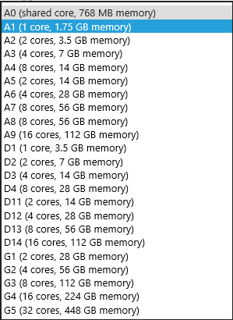
Virtual Machine Sizes
Compute Instance Name | Virtual Cores | RAM
Extra Small (A0) | Shared | 768 MB
Small (A1) | 1 | 1.75 GB
Medium (A2) | 2 | 3.5 GB
Large (A3) | 4 | 7 GB
Extra Large (A4) | 8 | 14 GB
General Purpose VMs
Compute Instance Name | Virtual Cores | RAM
A5 | 2 | 14 GB
A6 | 4 | 28 GB
A7 | 8 | 56 GB
Memory Intensive VMs
Compute Intensive VMs
Compute Instance Name | Virtual Cores | RAM | Networking
A8 | 8 | 56 GB | 40 Gbit/s InfiniBand
A9 | 16 | 112 GB | 40 Gbit/s InfiniBand
Each Persistent Data Disk Can be up to 1 TB with up to 16 disks per VM
http://azure.microsoft.com/en-us/pricing/details/virtual-machines/

Slide 7


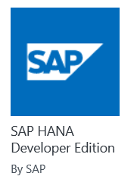
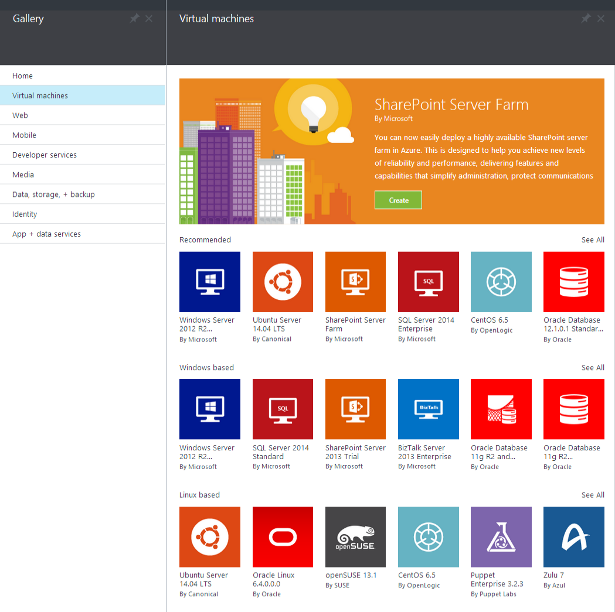

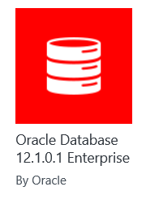
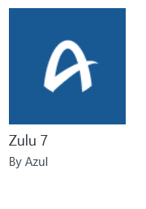
Galerie Azure

Slide 8
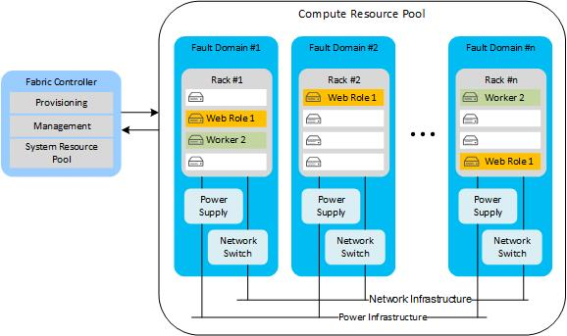
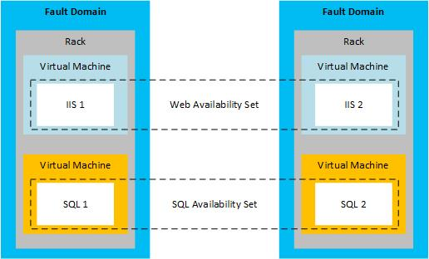
Groupes de disponibilité des VM : Domaines de pannes, Domaines de mise à jour
http://msdn.microsoft.com/en-us/library/dn251004.aspx

Slide 9
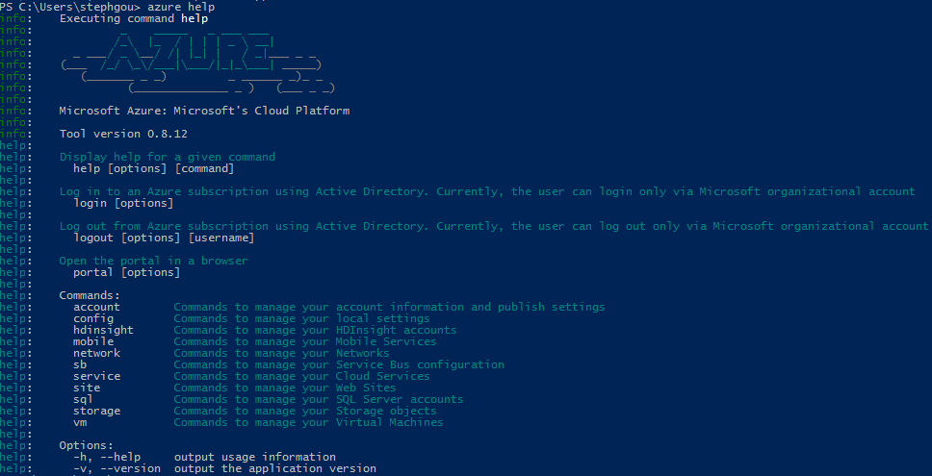
Provisioning par script ou API
prompt>
azure
topic
verb
options
Windows Azure Platform PowerShell cmdlets
http://azure.microsoft.com/en-us/documentation/articles/install-configure-powershell
Windows Azure command-line tool for Mac and Linux
http://www.windowsazure.com/en-us/documentation/articles/command-line-tools
REST API & Management Library
http://msdn.microsoft.com/en-us/library/azure/dn776326.aspx
account
account location
account affinity-group
vm
vm disk
vm endpoint
vm image
service
service cert
site
config
download
import
list
show
delete
start
restart
shutdown
capture
create
attach
detach
browse
set
username
password
dns-prefix
vm-name
lb-port
target-image-name
source-path
disk-image-name
size-in-gb
thumbprint
value
-v
-vv

Slide 10
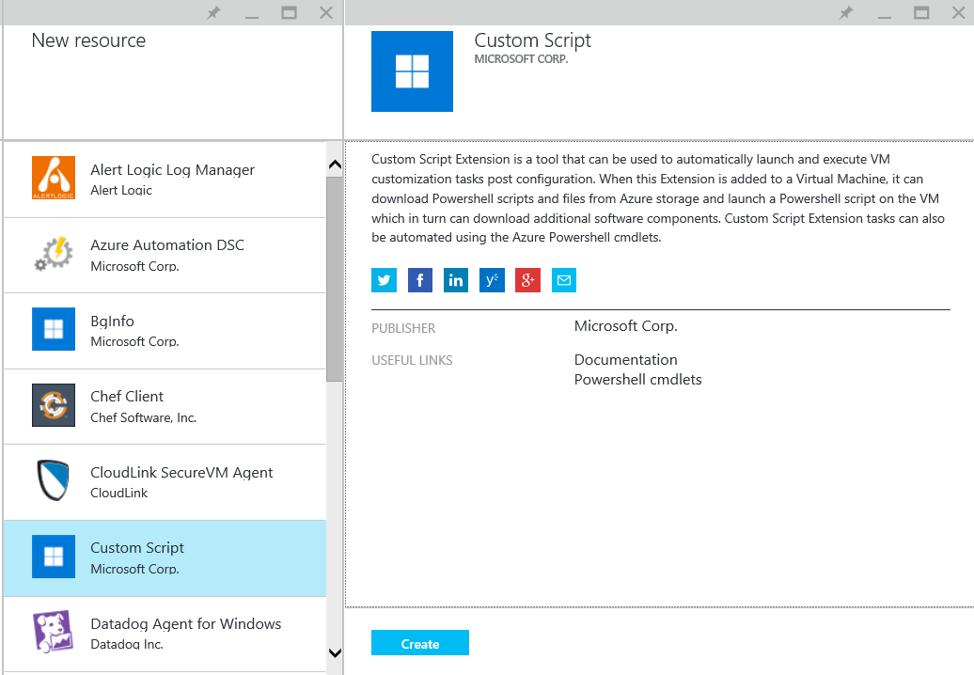
Extension de machine virtuelle Azure
IaaS Antimalware
Reset password
Docker
Backup
BGInfo
Bash Script PowerShell
PowerShell DSC
…
Set-AzureVMExtension -VM $vmConfig -ExtensionName "CustomScriptExtension" `
-Publisher "Microsoft.Compute" -Version 1.0 `
-PublicConfiguration $publicConfig -PrivateConfiguration $privateConfig
http://msdn.microsoft.com/en-us/library/azure/dn606311.aspx

Slide 12
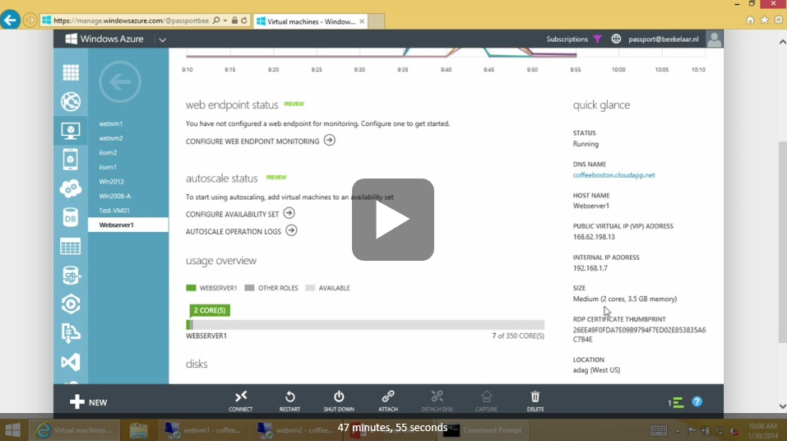
Pour aller plus loin…
https://channel9.msdn.com/series/Windows-Azure-IT-Pro-IaaS/02

